Slide 1
A phylogenomic investigation of Scutellaria reveals distinct patterns in flavonoid diversity

Slide 2
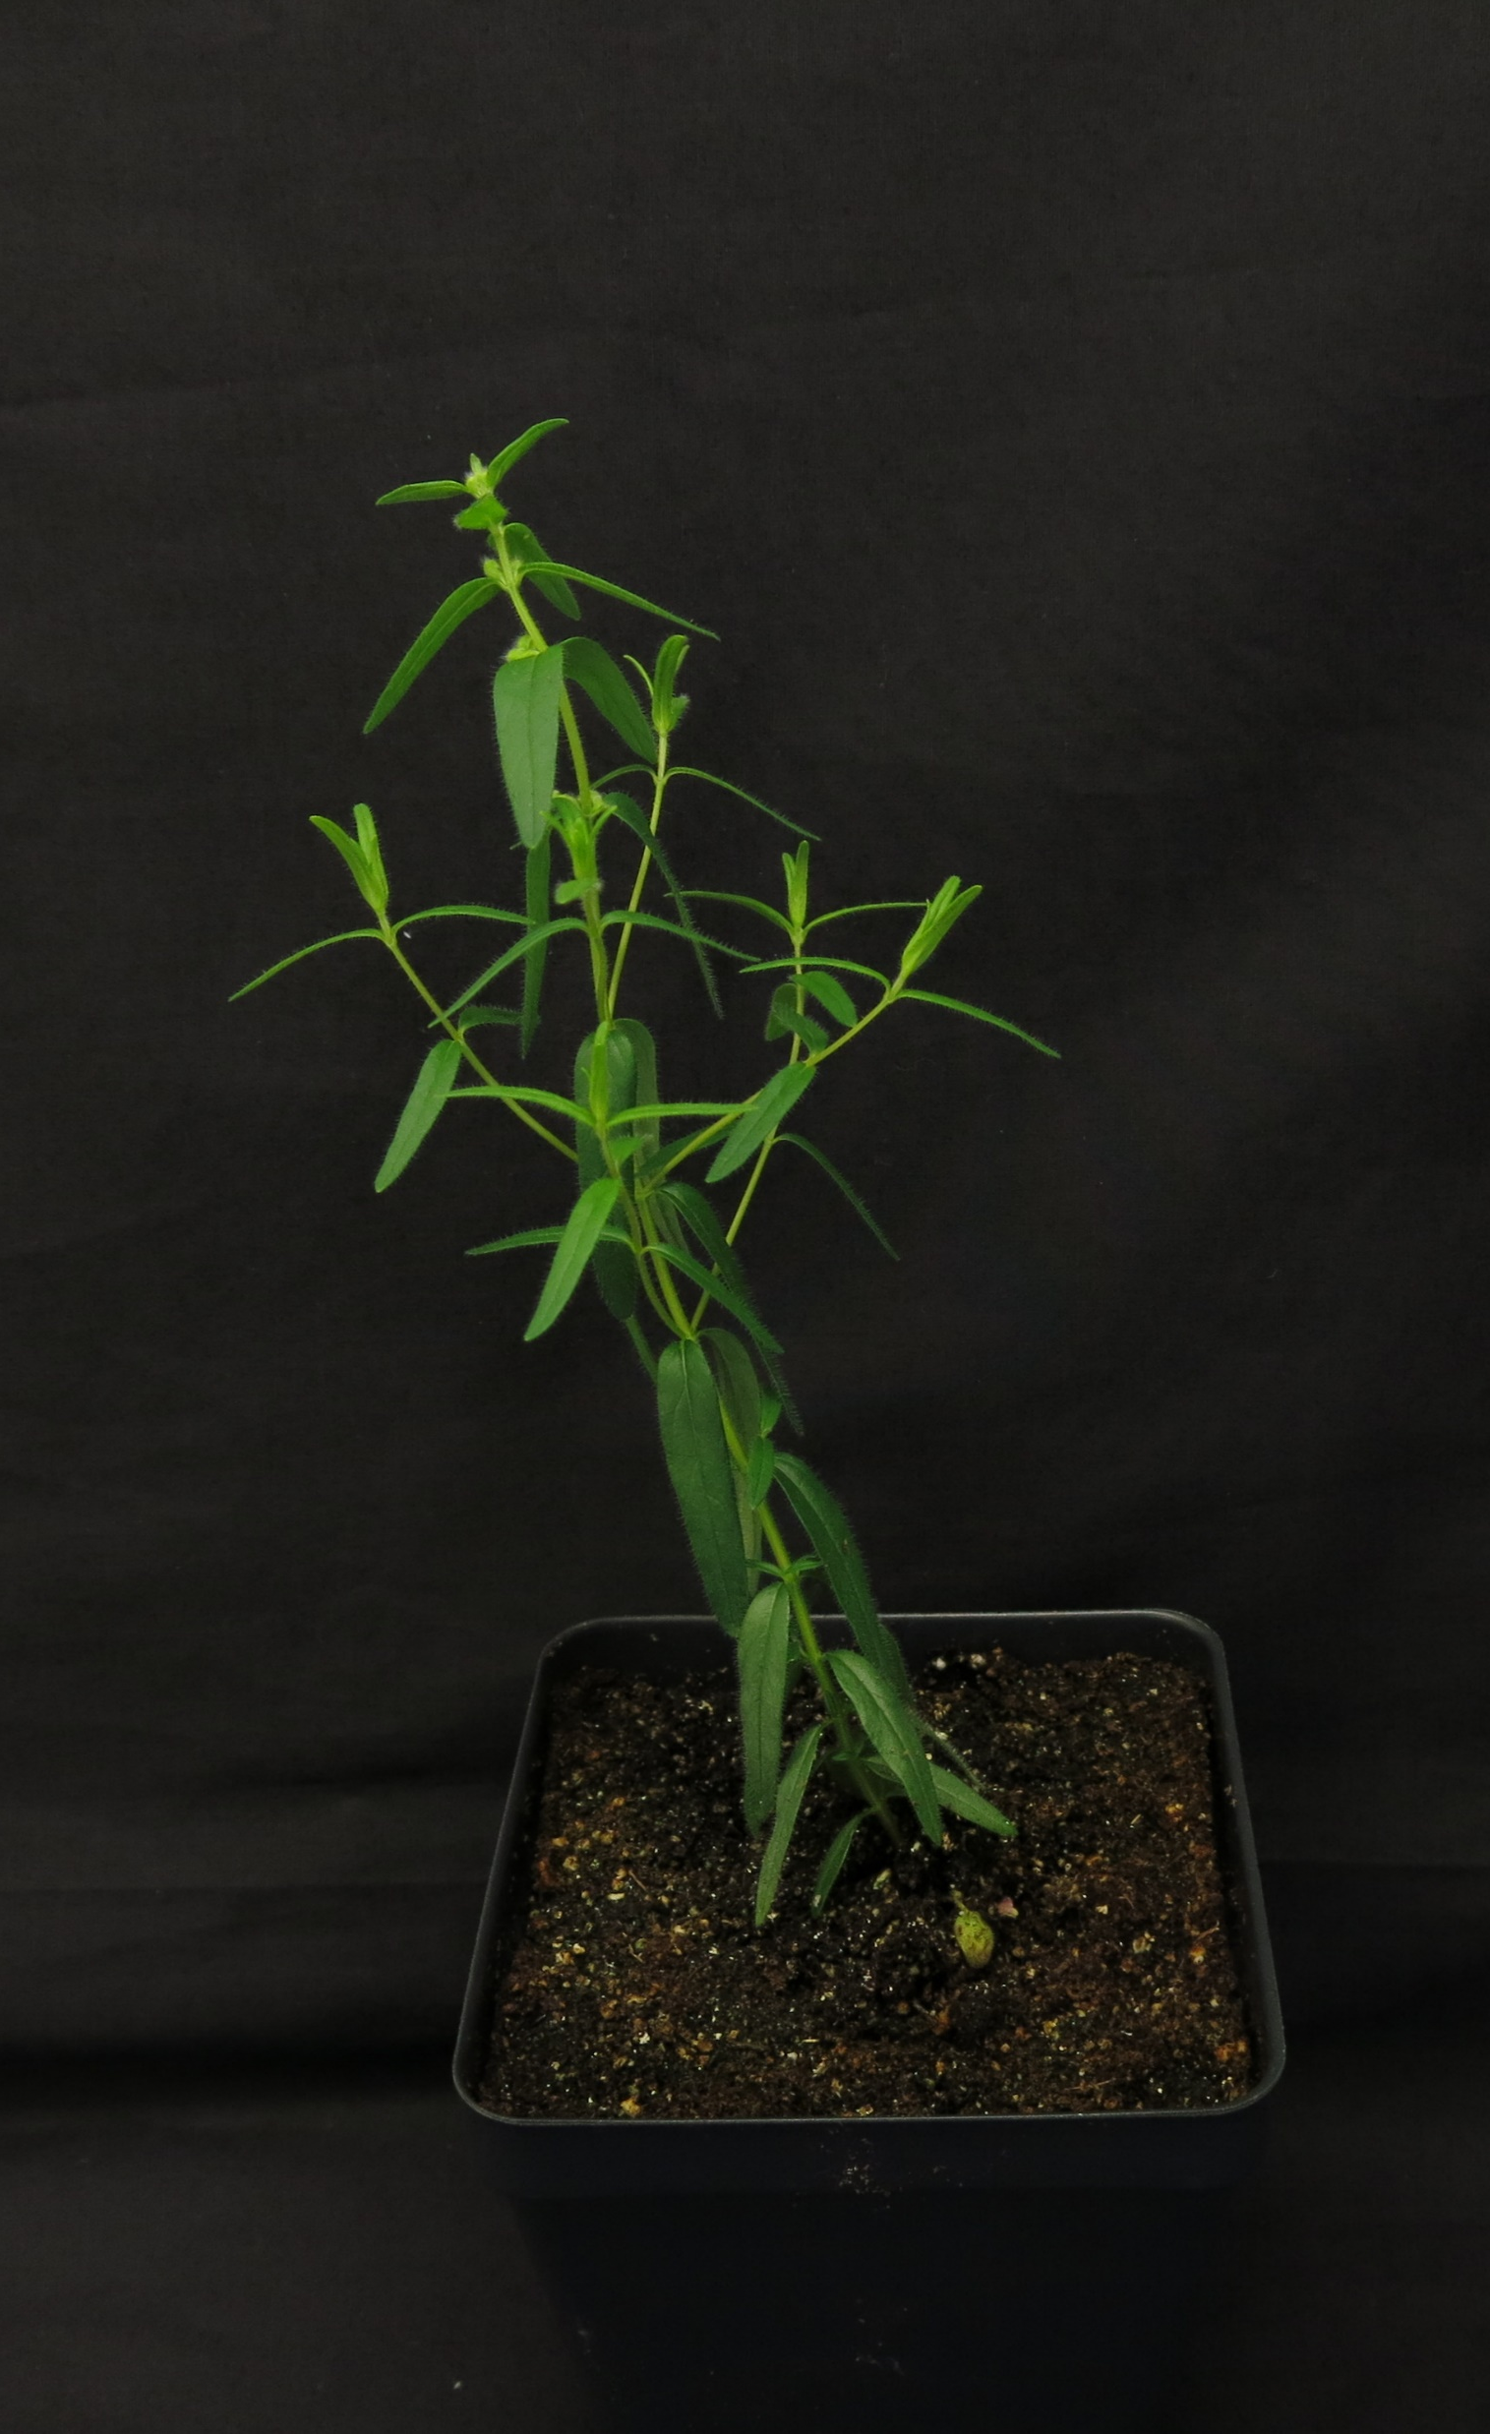
Introduction
Scutellaria baicalensis is a well-studied medicinal plant
Root extracts used in Eastern medicine
Possesses unique flavonoid biosynthetic pathway
Reference genome published in 2019
However, Scutellaria contains >470 other species
Many not well studied/not studied at all
Goal: assay a diverse set of Scutellaria species to provide insight into the evolutionary history and medicinal relevance of the genus

Slide 3
Table 1. Scutellaria tissue samples used in study
Species | Organ | Condition | Source
S. altissima | L, S, R | Fresh, herbarium | Seeds from …
S. galericulata | L, S | Herbarium
S. lateriflora | L, S, R | Fresh, herbarium
S. sapphirina | L, S | Herbarium
S. ovata | L | Herbarium
S. parvula | L, S | Herbarium
S serrata | L | Herbarium
S. tessellata | L, S | Herbarium
S. alpine | L, S | Herbarium
S. astinae | L, S | Herbarium
S. epilobiifolia | L, S | Herbarium
S. holmgreniorum | L, S | Herbarium
S. lutilaba | L, S | Herbarium
S. potosina | L, S | Herbarium
S. resinosa | L, S | Herbarium
S. siphocampuloides | L, S | Herbarium
S. coerulea | L | Herbarium
S. costaricana | L | Herbarium
S. formosa | L | Herbarium
S. hookeri | L | Herbarium

Slide 4
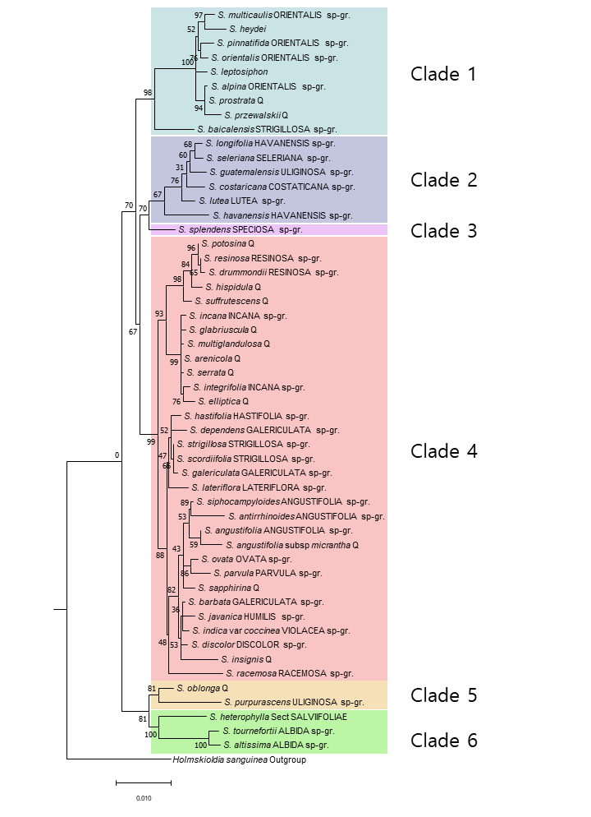
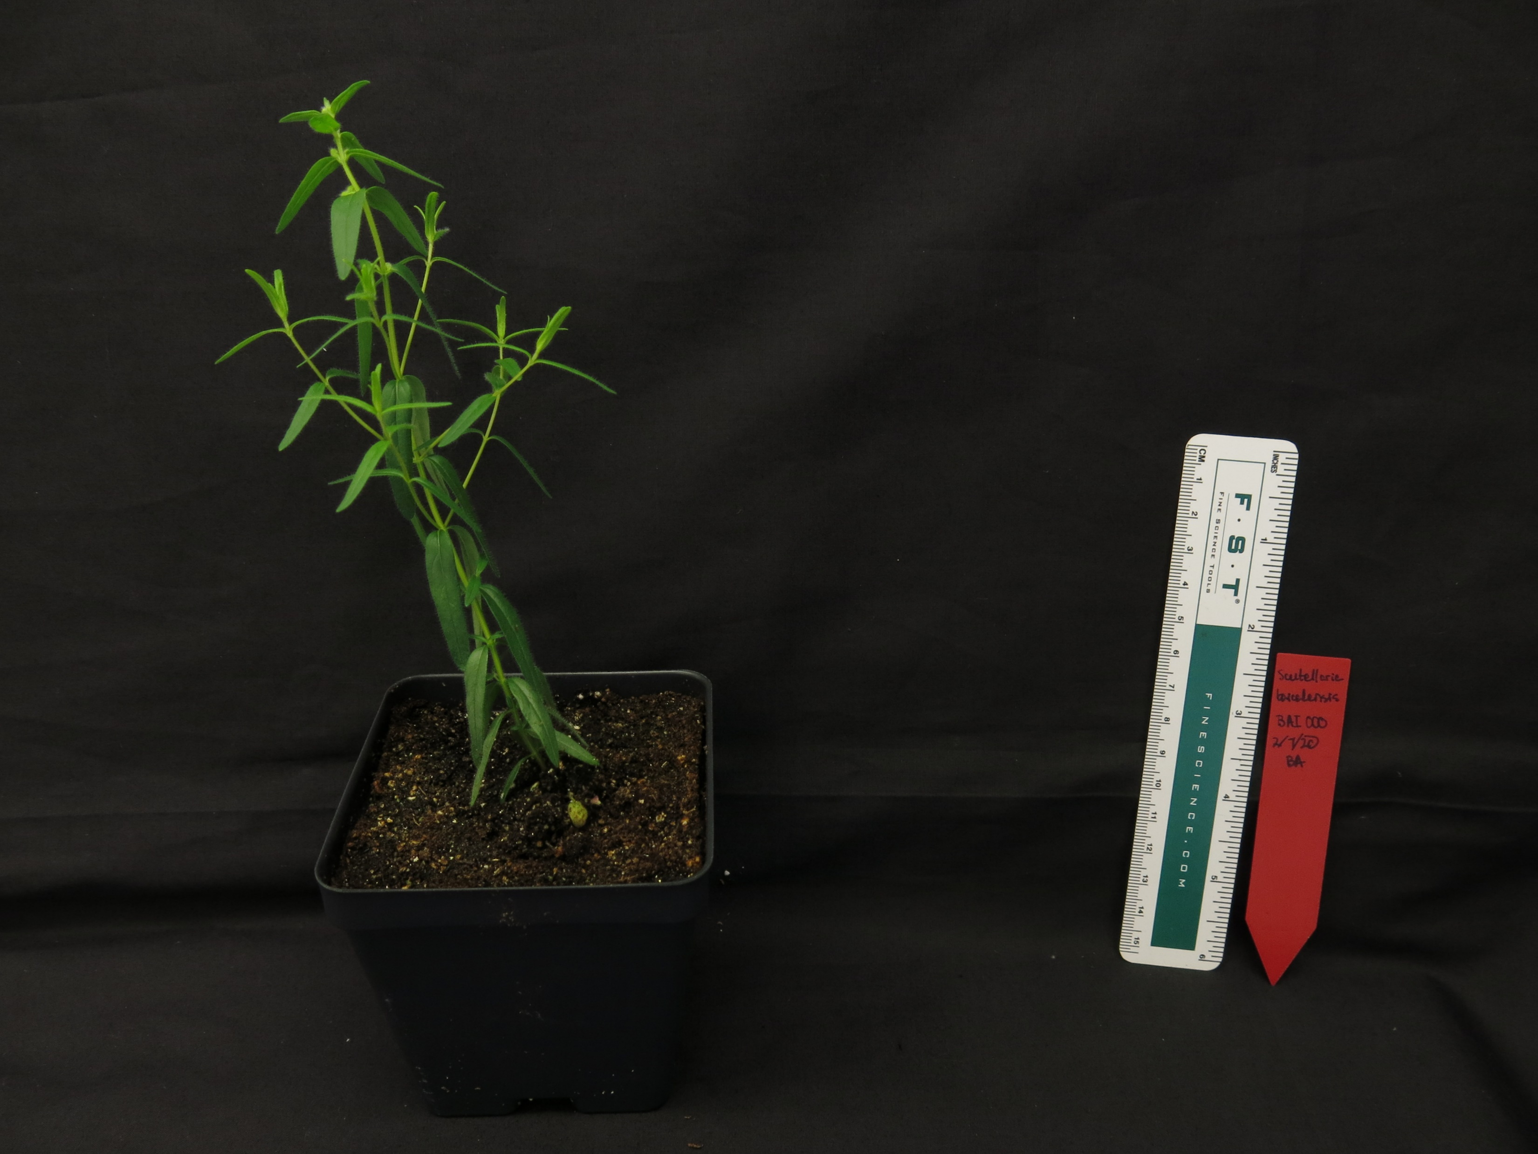
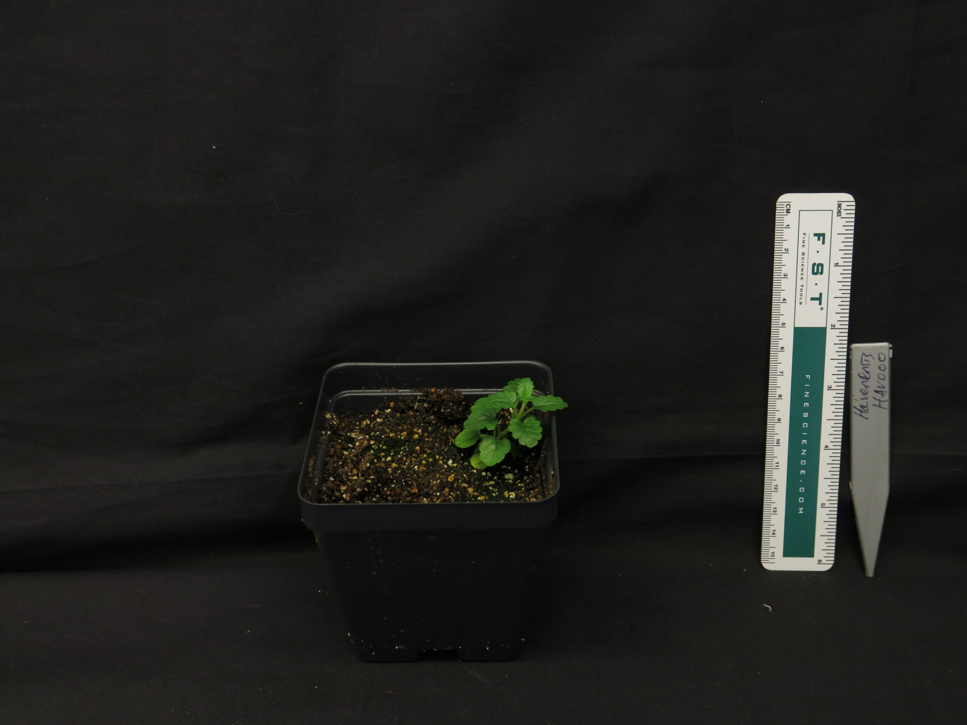
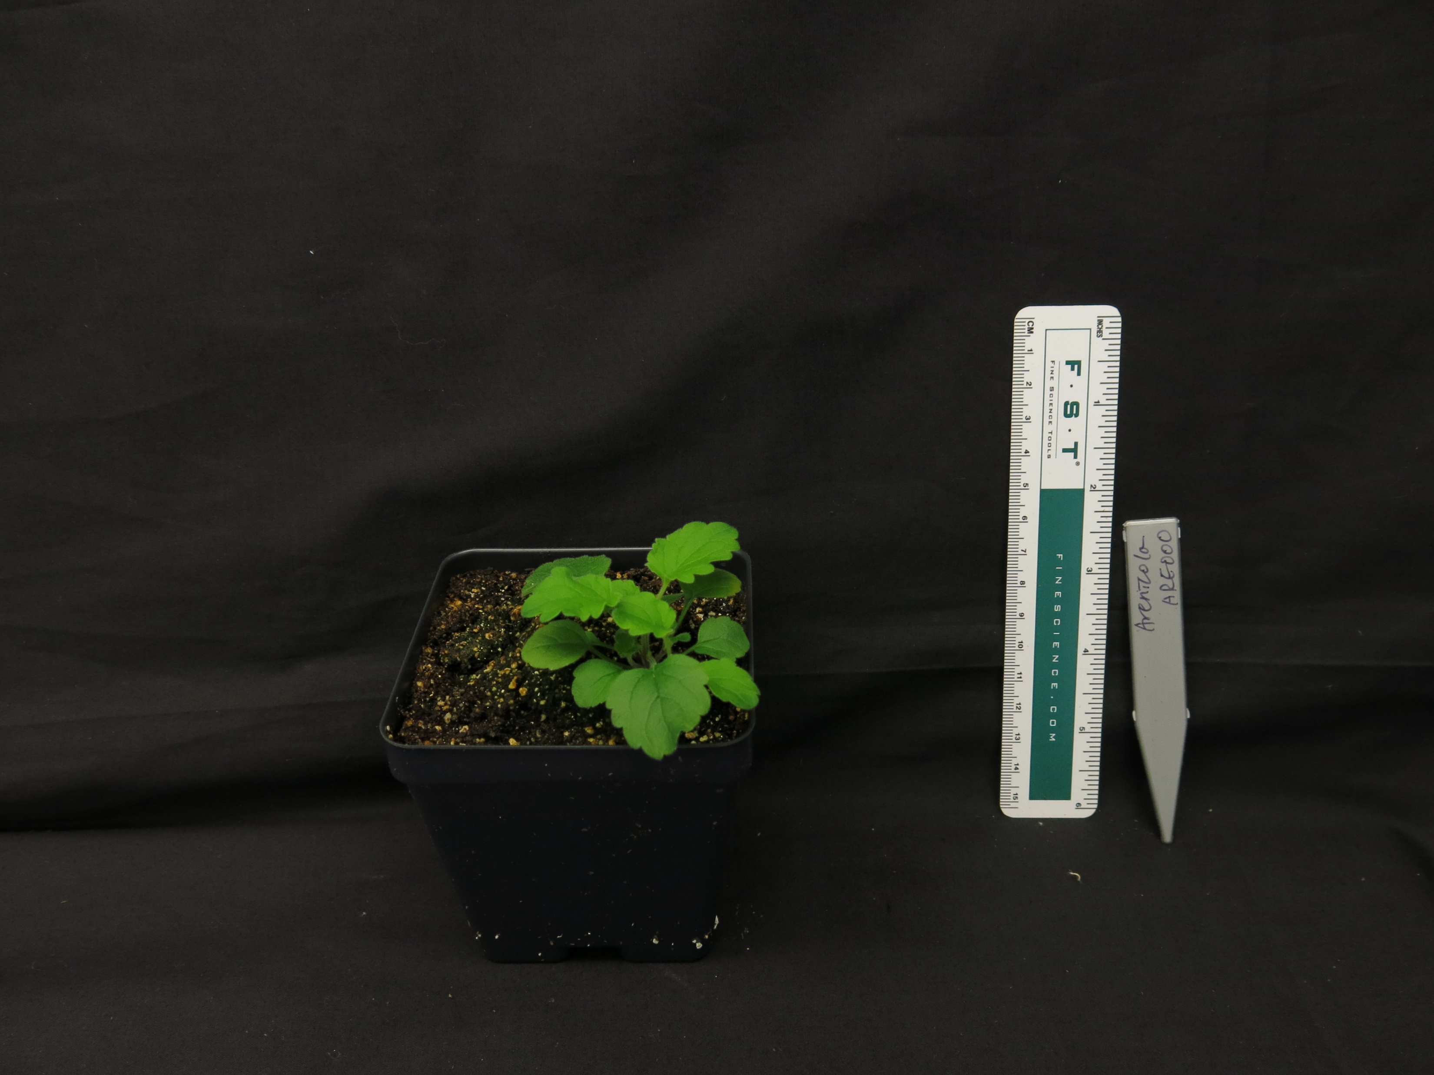
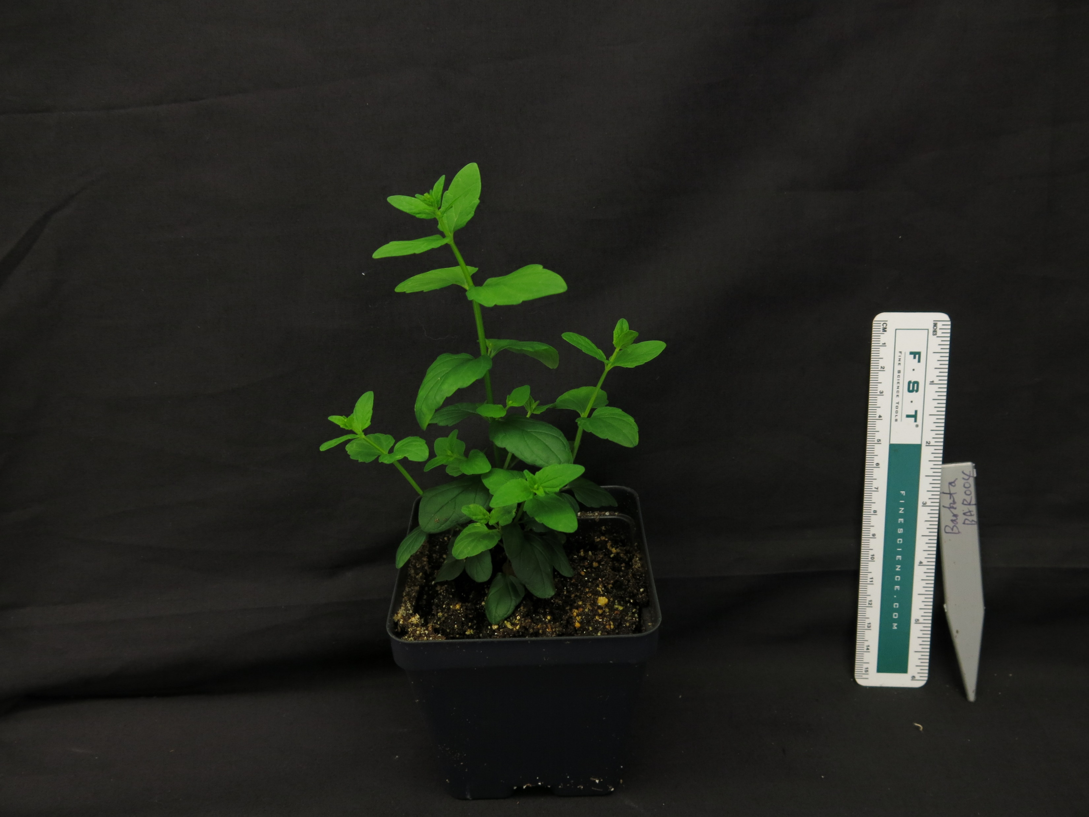
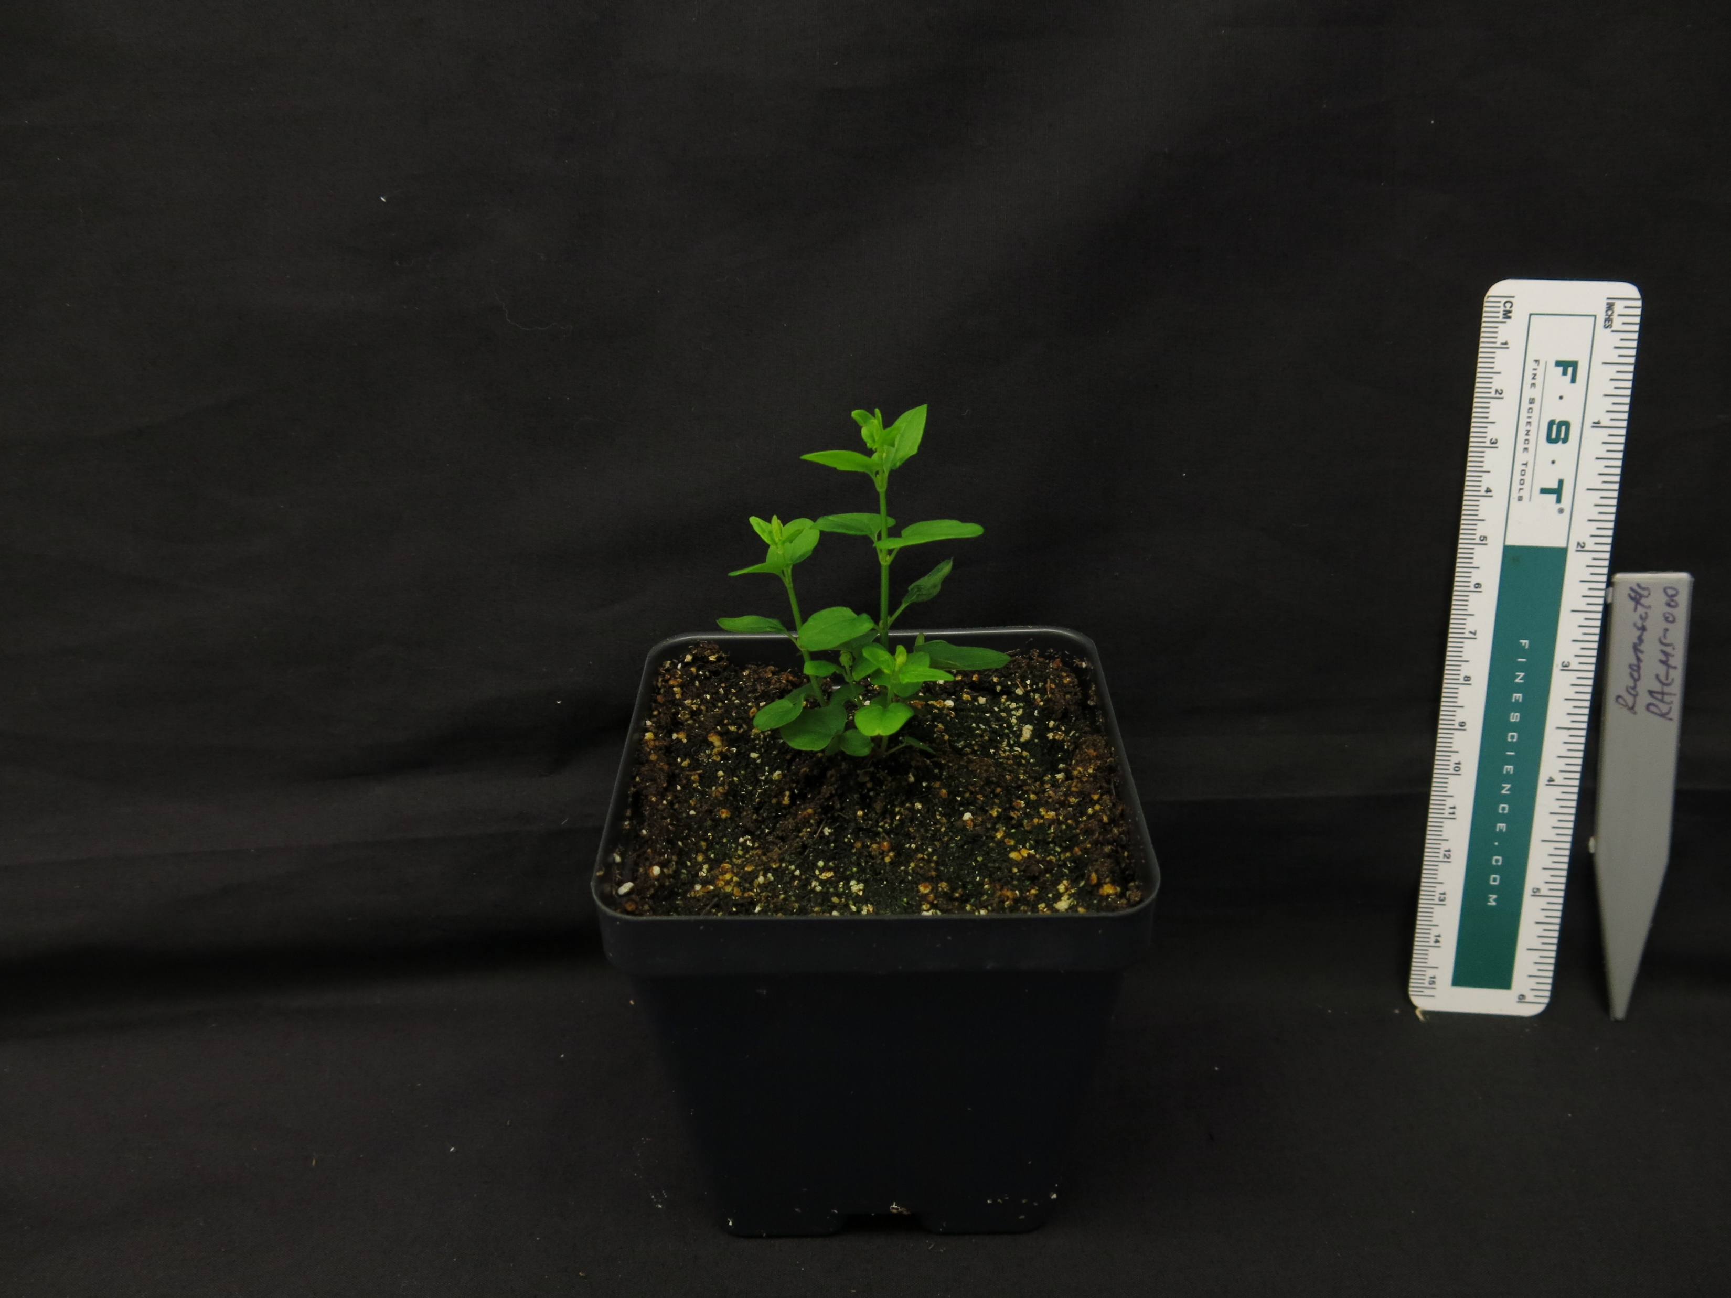
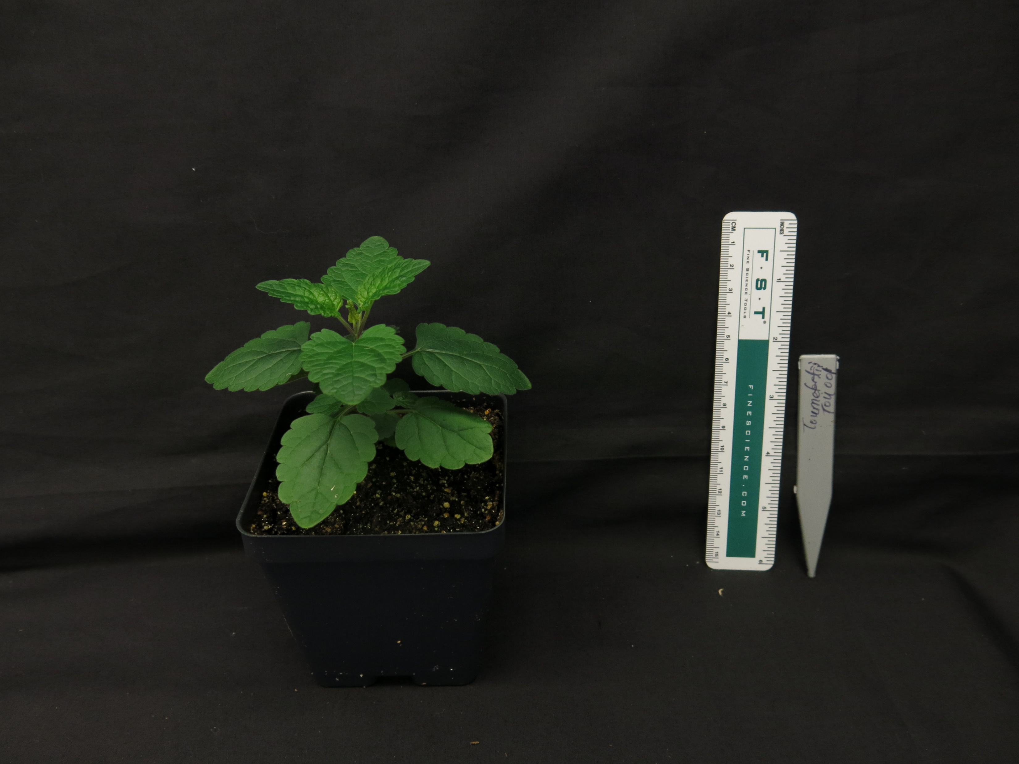
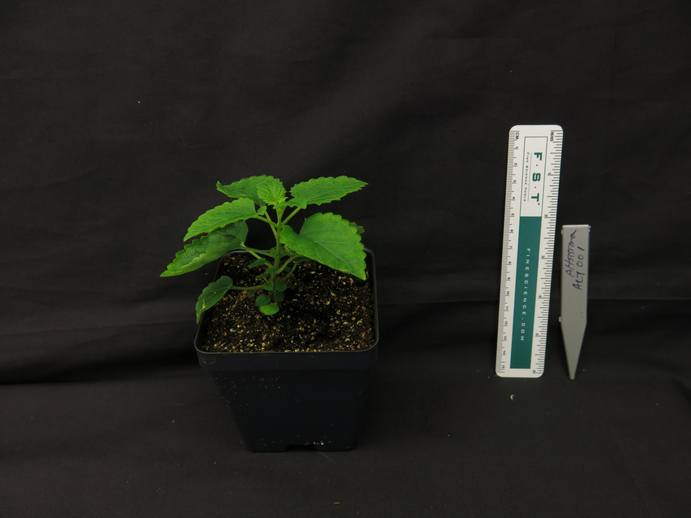
A.
B.
S. baicalensis
S. havanesis
S. arenicola
S. barbata
S. racemosa
S. tournefortii
S. altissima
Figure 1. (A) Maximum likelihood tree inferred from chloroplast genome data for 52 species of Scutellaria. To facilitate downstream analysis, the tree is subdivided into 6 clades. (B) Representative images of 7 species of Scutellaria. Colored circles next to species names indicate the clade which the species belongs to.

Slide 5
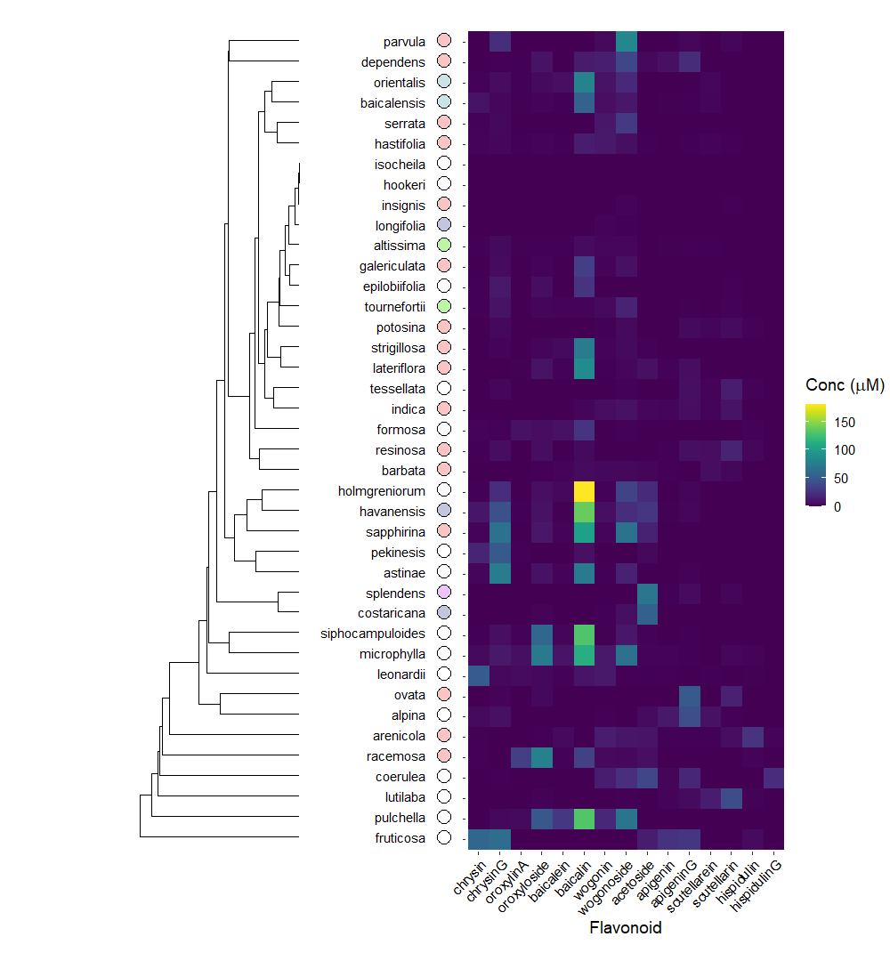
Figure 2. Heatmap of overall flavonoid concentrations measured with High Performance Liquid Chromatography (HPLC) of … species of Scutellaria. Ordering of species was determined by hierarchical clustering based on flavonoid concentration, as illustrated by the dendrogram to the right of the figure. Colored circles next to species names indicate phylogenetic clade, as shown in Figure 1. An empty circle indicates that the species was not included in the tree from Figure 1.

Slide 6
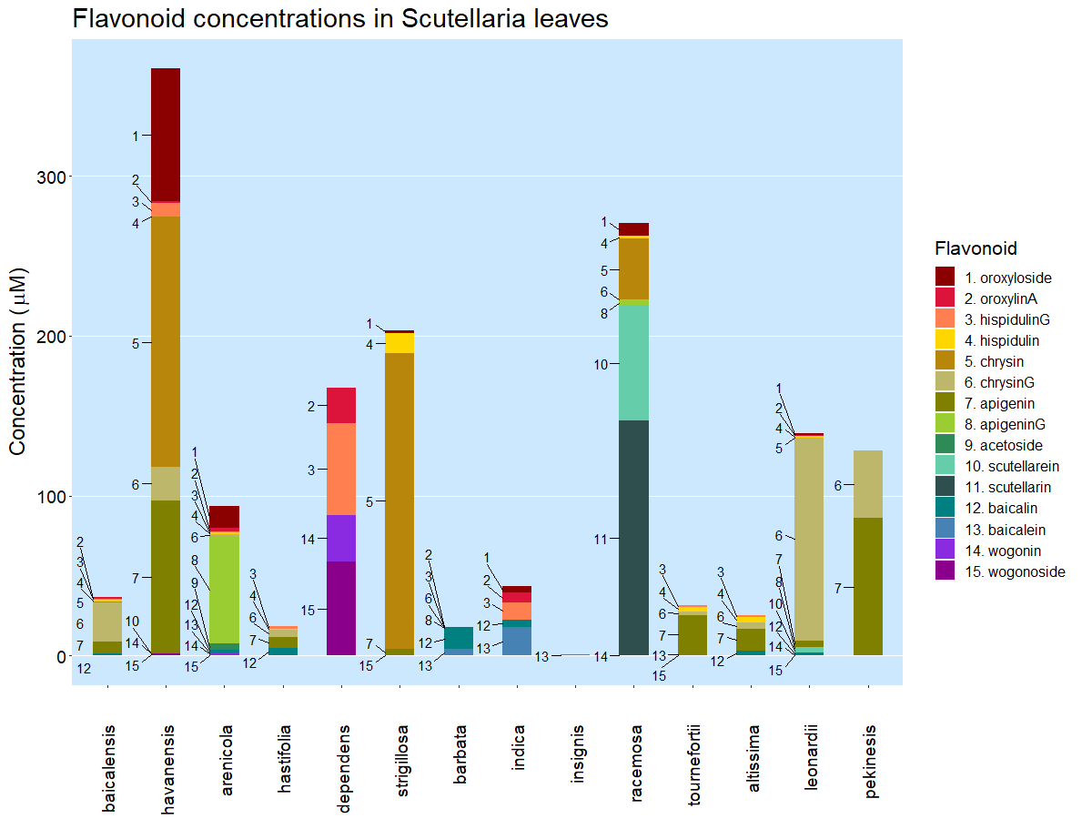
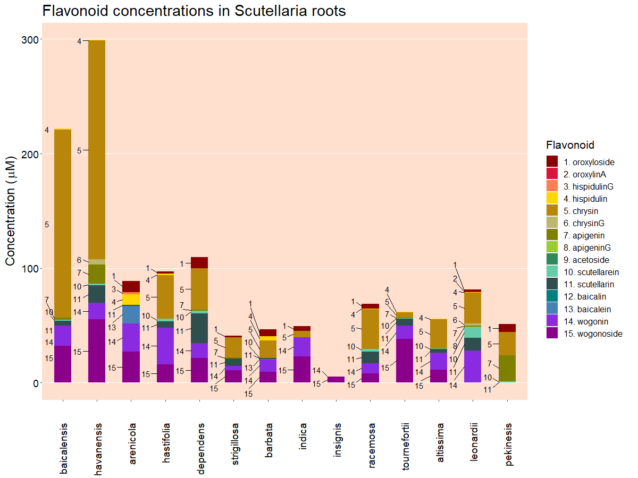
Leaf
Root
Figure 3. Organ-specific flavonoid data collected from 14 Scutellaria species via High Performance Liquid Chromatography (HPLC). Species are ordered based on phylogenetic relationship determine from chloroplast genome data, shown in Figure 1. Colored circles next to species names indicate phylogenetic clade, as shown in Figure 1. An empty circle indicates that the species was not included in the tree from Figure 1.

Slide 7
Table 2. Genome sizes as estimated by flow cytometry. Cell colors indicate phylogenetic clade, as shown in Figure 1.
Species | Genome size (Gbp) | Source
S. baicalensis | 0.54 | This study
S. havanensis | 0.37 | This study
S. arenicola | 0.85 | This study
S. hastifolia | 0.39 | This study
S. dependens | 0.44 | This study
S. strigillosa | 0.39 | Lee, Kim (2017)
S. barbata | 0.52 | This study
S. indica | 0.37 | Lee, Kim (2017)
S. insignis | 0.47 | Lee, Kim (2017)
S. racemosa | 0.44 | This study
S. tournefortii | 0.39 | This study
S. altissima | 0.39 | This study
S. leonardii | 0.50 | This study
S. pekenesis | 0.38 | This study

Slide 8
Figure 4. Proposed modifications to S. baicalensis flavonoid pathway

